Slide 1
Sesi 3 Percabangan dan Perulangan
By :
Ng Poi Wong, S.Kom., M.T.I.
Khristian Tanselmus, S.Kom., M.TI.

Slide 2
Percabangan dan Perulangan
Operator Logika
Operator Ternary
Percabangan IF
Percabangan SWITCH
Perulangan DO
Perulangan WHILE
Perulangan FOR
Interupsi Perulangan

Slide 3
Operator Logika
Operator | Category | Example Expression | Result
== | Binary | var1 = var2 == var3; | var1 = true IF var2 = var3, or false otherwise
!= | Binary | var1 = var2 != var3; | var1 = true IF var2 <> var3, or false otherwise
< | Binary | var1 = var2 < var3; | var1 = true IF var2 < var3, or false otherwise
> | Binary | var1 = var2 > var3; | var1 = true IF var2 > var3, or false otherwise
<= | Binary | var1 = var2 <= var3; | var1 = true IF var2 <= var3, or false otherwise
>= | Binary | var1 = var2 >= var3; | var1 = true IF var2 >= var3, or false otherwise

Slide 4
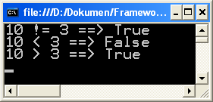
Contoh
bool var1;
int var2 = 10, var3 = 3;
var1 = var2 != var3;
Console.WriteLine("{0} != {1} ==> {2}", var2, var3, var1);
var1 = var2 < var3;
Console.WriteLine("{0} < {1} ==> {2}", var2, var3, var1);
var1 = var2 > var3;
Console.WriteLine("{0} > {1} ==> {2}", var2, var3, var1);
Console.ReadKey();

Slide 5
Operator Logika
Operator | Category | Example Expression | Result
! | Unary | var1 = !var2; | var1 = true IF var2 = false, or false IF var2 = true (Logical NOT)
& | Binary | var1 = var2 & var3; | var1 = true IF var2 = var3 = true, or false otherwise (Logical AND)
| | Binary | var1 = var2 | var3; | var1 = true IF var2 or var3 (or both) = true, or false otherwise (Logical OR)
^ | Binary | var1 = var2 ^ var3; | var1 = true IF either var2 or var3 but not both = true, or false otherwise (Logical XOR)

Slide 6
Operator Logika
Operator | Category | Example Expression | Equivalent
&= | Binary | var1 &= var2; | var1 = var1 & var2;
|= | Binary | var1 |= var2; | var1 = var1 | var2;
^= | Binary | var1 ^= var2; | var1 = var1 ^ var2;

Slide 7
Contoh
bool var1, var2, var3;
var2 = var3 = true;
var2 = !var3;
Console.WriteLine("var2 = {0}, var3 = {1}\n", var2, var3);
var1 = var2 & var3;
Console.WriteLine("var1 = var2 AND var3");
Console.WriteLine("var1 = {0}, var2 = {1}, var3 = {2}\n", var1, var2, var3);
var2 |= var3;
Console.WriteLine("var2 = var2 OR var3");
Console.WriteLine("var1 = {0}, var2 = {1}, var3 = {2}\n", var1, var2, var3);

Slide 8
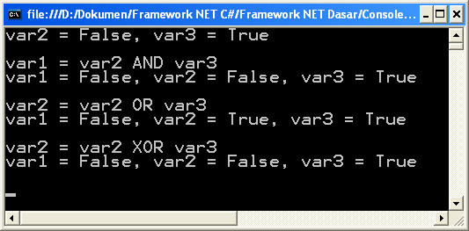
Contoh
var2 ^= var3;
Console.WriteLine("var2 = var2 XOR var3");
Console.WriteLine("var1 = {0}, var2 = {1}, var3 = {2}\n", var1, var2, var3);
Console.ReadKey();

Slide 9
Operator Logika
Operator | Category | Example Expression | Result
&& | Binary | var1 = var2 && var3; | var1 = true IF var2 and var3 expression condition are both true, or false otherwise (Logical AND)
|| | Binary | var1 = var2 || var3; | var1 = true IF either var2 or var3 (or both) expression condition is true, or false otherwise (Logical OR)

Slide 10
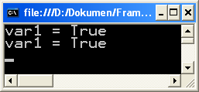
Contoh
bool var1;
int var2, var3;
var2 = 25;
var3 = -100;
var1 = (var2 >= 0) && (var2 < 100);
Console.WriteLine("var1 = {0}", var1);
var1 = (var3 <= 0) || (var3 >= 100);
Console.WriteLine("var1 = {0}", var1);
Console.ReadKey();

Slide 11
Operator Bitwise
Operator | Category | Example Expression | Result
>> | Binary | var1 = var2 >> var3; | var1 = binary content of var2 is shifted var3 bits to the right
<< | Binary | var1 = var2 << var3; | var1 = binary content of var2 is shifted var3 bits to the left
Operator | Category | Example Expression | Equivalent
>>= | Unary | var1 >>= var2; | var1 = var1 >> var2;
<<= | Unary | var1 <<= var2; | var1 = var1 << var2;

Slide 12
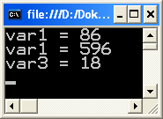
Contoh
int var1, var2, var3;
var2 = 172; //1010 1100
var3 = 149; //1001 0101
var1 = var2 >> 1; //0101 0110
Console.WriteLine("var1 = {0}", var1);
var1 = var3 << 2; //0010 0101 0100
Console.WriteLine("var1 = {0}", var1);
var3 >>= 3; //0001 0010
Console.WriteLine("var3 = {0}", var3);
Console.ReadKey();

Slide 13
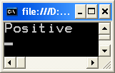
Operator Ternary
Merupakan operator dengan 3 operand
Merupakan bagian dari percabangan
<test> ? <resultIfTrue> : <resultIfFalse>
Contoh :
int var = 20;
Console.WriteLine(var >= 0 ? "Positive" : "Negative");
Console.ReadKey();

Slide 14
Percabangan IF
Terdapat percabangan untuk 1 kondisi, 2 kondisi, banyak kondisi, dan kondisi bersarang.
Struktur percabangan IF dengan 1 kondisi :
if (<test>)
<code executed if <test> is true>;
Struktur percabangan IF dengan 2 kondisi :
if (<test>)
<code executed if <test> is true>;
else
<code executed if <test> is false>;

Slide 15
Percabangan IF
Struktur percabangan IF dengan banyak kondisi :
if (<test1>)
<code executed if <test1> is true>;
else if (<test2>)
<code executed if <test2> is true>;
else if (<test3>)
<code executed if <test3> is true>;
………
else
<code executed if all above <test> is false>;

Slide 16
Percabangan IF
Struktur Percabangan IF jika baris kode masing-masing kondisi terdiri dari banyak baris :
if (<test>)
{
<code executed if <test> is true>;
}
else
{
<code executed if <test> is false>;
}

Slide 17
Percabangan IF
Struktur percabangan IF dengan kondisi bersarang :
if (<test1>)
{
<code executed if <test1> is true>;
}
else
{
if (<test2>)
{
<code executed if <test2> is true>;
}
else
{
<code executed if <test2> is false>;
}
}

Slide 18
Percabangan IF
double var1, var2;
Console.Write("Angka-1 = ");
var1 = Convert.ToDouble(Console.ReadLine());
Console.Write("Angka-2 = ");
var2 = Convert.ToDouble(Console.ReadLine());
if (var1 == var2)
{
Console.ForegroundColor = ConsoleColor.Green;
Console.WriteLine("{0} = {1}", var1, var2);
}

Slide 19
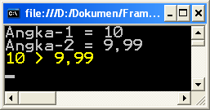
Percabangan IF
else if (var1 < var2)
{
Console.ForegroundColor = ConsoleColor.Blue;
Console.WriteLine("{0} < {1}", var1, var2);
}
else
{
Console.ForegroundColor = ConsoleColor.Yellow;
Console.WriteLine("{0} > {1}", var1, var2);
}
Console.ReadKey();

Slide 20
Percabangan SWITCH
Merupakan percabangan dengan nilai kondisi tunggal, tidak dapat dipergunakan untuk kondisi nilai range.

Slide 21
Percabangan SWITCH
Struktur dasar dari percabangan SWITCH :
switch (<testVar>)
{
case <comparisonVal1>:
<code to execute if <testVar> == <comparisonVal1> >
break;
case <comparisonVal2>:
<code to execute if <testVar> == <comparisonVal2> >
break;
case <comparisonVal3>:
<code to execute if <testVar> == <comparisonVal3> >
break;
...

Slide 22
Percabangan SWITCH
case <comparisonValN>:
<code to execute if <testVar> == <comparisonValN> >
break;
default:
<code to execute if <testVar> != comparisonVals>
break;
}

Slide 23
Percabangan SWITCH
Percabangan SWITCH dengan lintas kondisi :
switch (<testVar>)
{
case <comparisonVal1>:
<code to execute if <testVar> == <comparisonVal1> >
goto case <comparisonVal2>;
case <comparisonVal2>:
<code to execute if <testVar> == <comparisonVal2> >
break;
...

Slide 24
Percabangan SWITCH
Percabangan SWITCH dengan multi kondisi :
switch (<testVar>)
{
case <comparisonVal1>:
case <comparisonVal2>:
<code to execute if <testVar> == <comparisonVal1> or <testVar> == <comparisonVal2> >
break;
...

Slide 25
Percabangan SWITCH
int var;
Console.Write("Input sembarang angka = ");
var = Convert.ToInt32(Console.ReadLine());
Console.Write("Keterangan = ");
switch (var)
{
case 0:
Console.Write("Nol");
break;

Slide 26
Percabangan SWITCH
case 1:
case 3:
case 5:
case 7:
case 9:
Console.Write("Ganjil");
break;

Slide 27
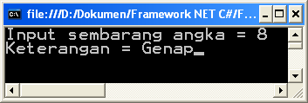
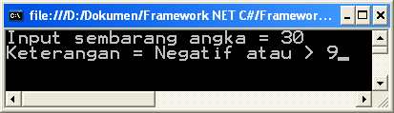
Percabangan SWITCH
case 2:
case 4:
case 6:
case 8:
Console.Write("Genap");
break;
default:
Console.Write("Negatif atau > 9");
break;
}
Console.ReadKey();

Slide 28
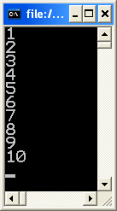
Perulangan DO
Perulangan dimana akan dieksekusi minimal 1 kali.
do
{
<code to be looped>
} while (<Test>);
Contoh :
int i = 1;
do
{
Console.WriteLine(i++);
} while (i <= 10);

Slide 29
Perulangan WHILE
Perulangan dimana akan divalidasi lebih dahulu kriterianya sebelum dieksekusi perulangan.
while (<Test>)
{
<code to be looped>
}
Contoh :
int i = 1;
while (i <= 10)
{
Console.WriteLine(i++);
}

Slide 30
Perulangan FOR
Perulangan dimana jumlah perulangan telah ditentukan dari awal.
for (<initialization>; <condition>; <operation>)
{
<code to loop>
}
Dimana :
<initialization> = Kondisi awal
<condition> = Kondisi akhir
<operation> = Operasi iterator

Slide 31
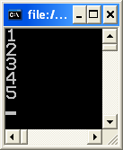

Perulangan FOR
int i;
for (i = 1; i <= 5; i++)
Console.WriteLine(i);
Console.ReadKey();
int i;
for (i = 5; i > 0; i--)
Console.WriteLine(i);
Console.ReadKey();

Slide 32

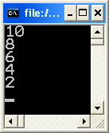
Perulangan FOR
for (int i = 1; i <= 10; i += 2)
Console.WriteLine(i);
Console.ReadKey();
for (int i = 10; i > 0; i -= 2)
Console.WriteLine(i);
Console.ReadKey();

Slide 33
Interupsi Perulangan
Berfungsi untuk mengendalikan proses di tengah perulangan.
Terdiri dari perintah :
break : menghentikan perulangan secara mendadak.
continue : lompat ke perulangan berikutnya.
goto : lompat ke label tertentu.
return : keluar dari fungsi (akan dibahas pada Sesi Fungsi).

Slide 34
Interupsi Perulangan
int i = 1;
while (i <= 10)
{
if (i == 6)
break;
Console.WriteLine(i++);
}
Console.ReadKey();

Slide 35
Interupsi Perulangan
for (int i = 1; i <= 10; i++)
{
if (i % 2 == 0)
continue;
Console.WriteLine(i);
}
Console.ReadKey();

Slide 36
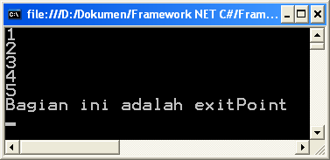
Interupsi Perulangan
int i = 1;
while (i <= 10)
{
if (i == 6)
goto exitPoint;
Console.WriteLine(i++);
}
Console.WriteLine("Bagian ini tidak akan pernah dicapai");
exitPoint:
Console.WriteLine("Bagian ini adalah exitPoint");
Console.ReadKey();

Slide 37
Tanya Jawab

